Slide 1
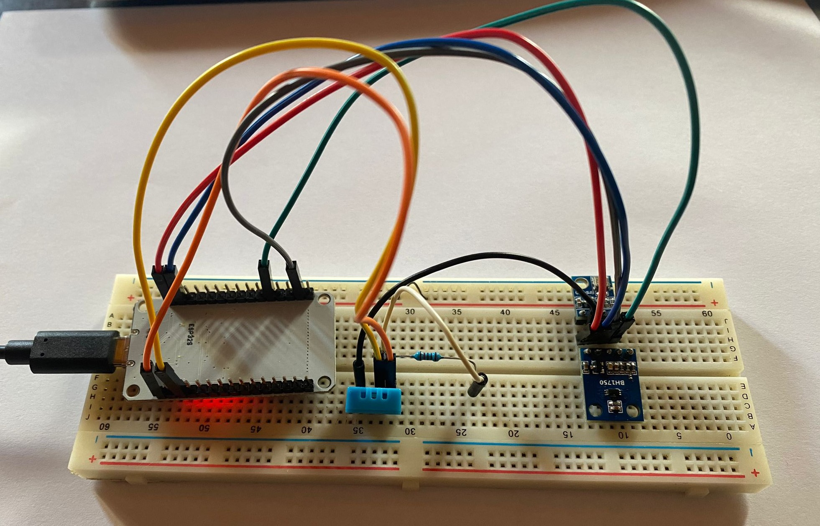
Distributed Weather Station
University of Trento
Embedded Software for the Internet of Things
Brognara Alessandro
Cappellaro Nicola
Zannoni Riccardo

Slide 2
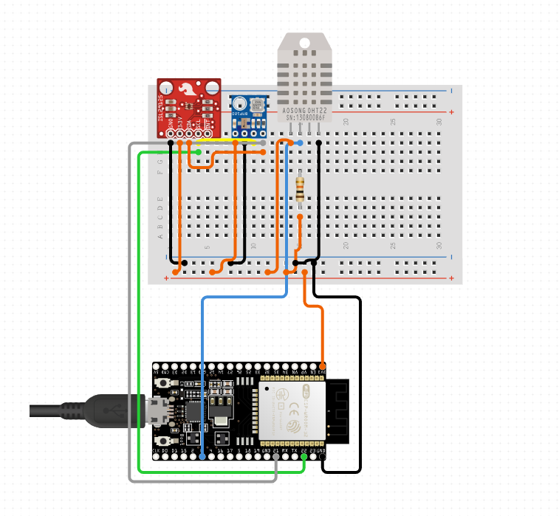
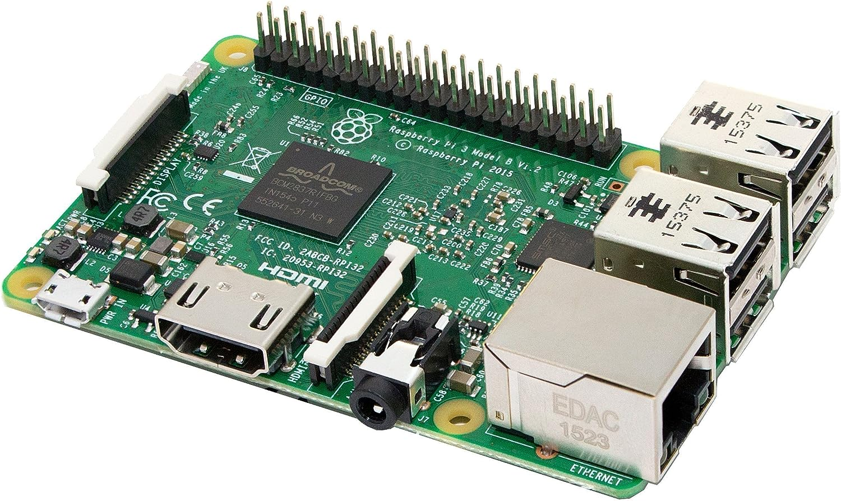
Project description:
what is the goal of the project?
Our project is a distributed weather station with:
-a central server;
-some weather stations with sensors
The stations periodically carry out a measurement of meteorological data (temperature, humidity, pressure, altitude and light intensity) and send it to a web server which allows the data to be displayed.

Slide 3
Software Architecture
4. raspberry display the data with a nodeJs web server
ESP32
Web
1. esp32 connect to wifi
2. interrupt function read the sensor data and prepare a json
Interrupt
Raspberry
3. the json is sent to the server

Slide 4
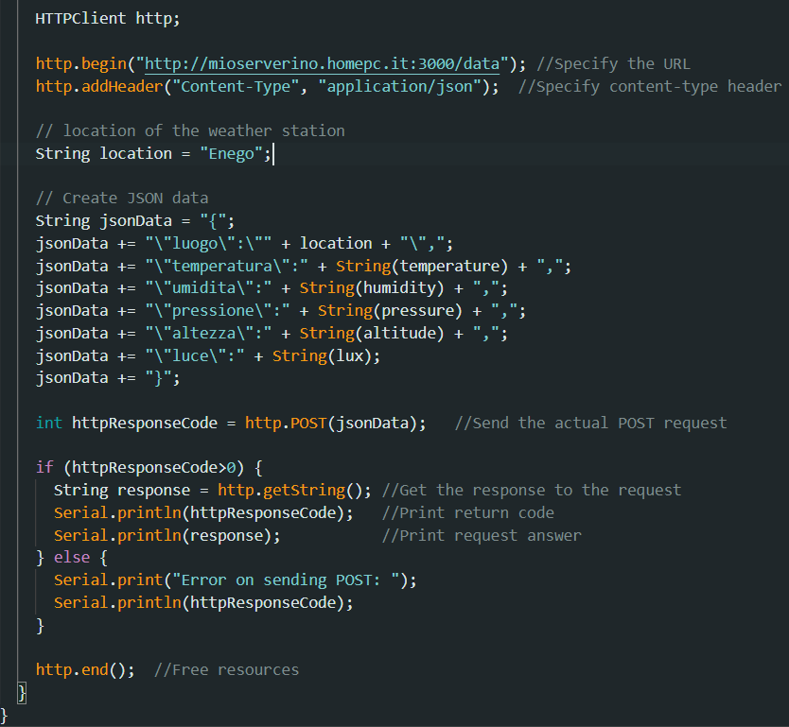
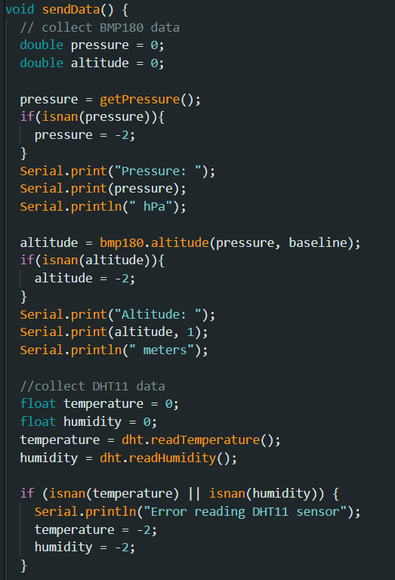
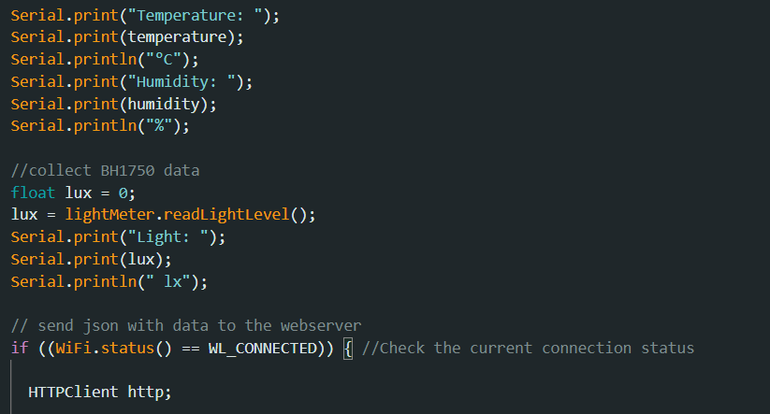
Representative code and Testing

Slide 5

Conclusion and Future Work
In conclusion we learned to use a new esp32 microcontroller and created the circuit to read the data from the sensors, plus connected the project to the internet making it complete in every area.
In the future we can implement:
add different sensors
add more station
implement a database system

